Slide 1
TWEET BOT
JAY KISHAN PANJIYAR

Slide 2
PROBLEM STATEMENT
BLIND NON-FRIENDLY APPLICATION
UNABLE TO NAVIGATE SOCIAL MEDIA APPS
UNABLE TO READ SOCAIL MEDIA CONTENT
COST OF SMART PHONES
Not a plug and play device

Slide 3
OUR SOLUTION
PLUG AND PLAY DEVICES
READING TWEETS IN SPEECH FORM
VOICE, RATE, PITCH CAN BE VARIED
Can be broadcasted

Slide 4
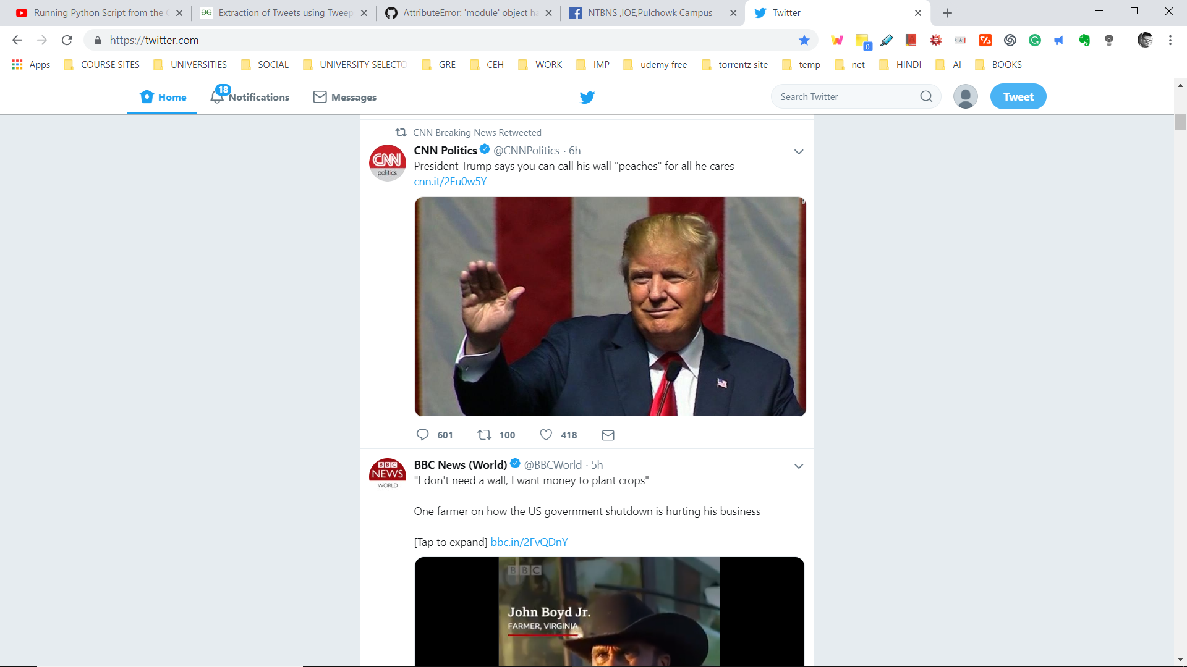

Slide 5
FEASIBLITY
ECONOMICAL
EASY TO CONFIGURE
Complete product

Slide 6
FUTURE ENHANCEMENT
FACEBOOK, INSTAGRAM
BROADCASTING OVER AN ORGANIZATION
Enhanced UI

